Slide 1

Discrete Simulation of the motion of underwater Soft Robotic Gripper
Ben Forbes
Mechanical Engineering
Premkumar Sivakumar
Mechanical Engineering

Slide 2
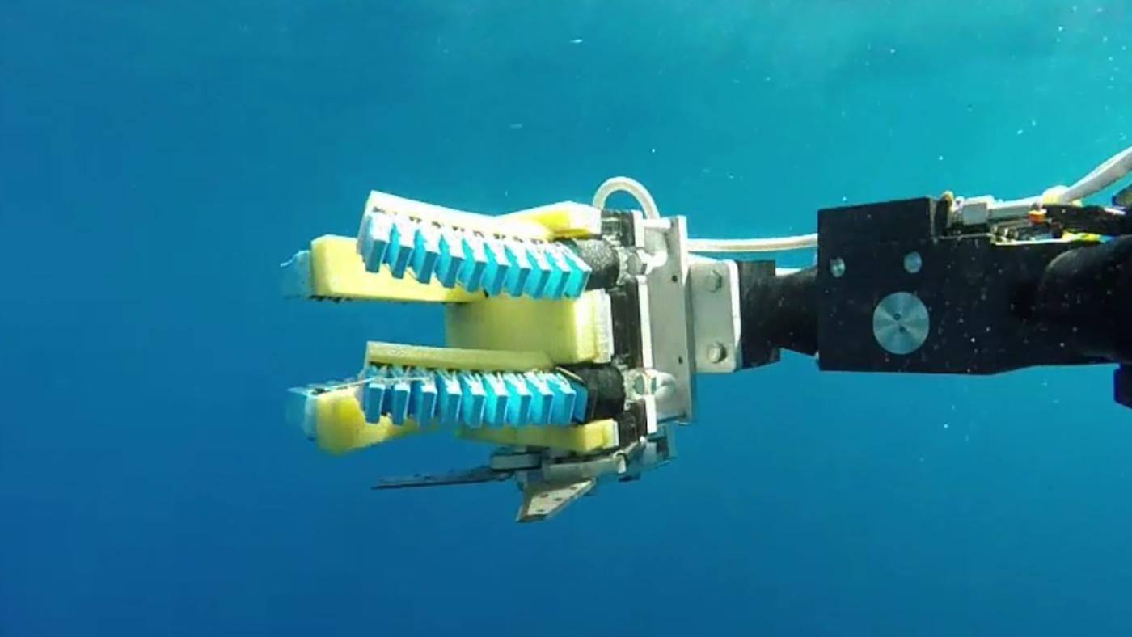
Background
Traditional robotic grippers:
Lack adaptability
Damage fragile objects
Soft robotic grippers:
Pneumatics – pressure differential with localized bending or stretching
Soft plastic or elastomer that contain intrinsic elastic properties
EOM from geometry and pressure differential, then FEA
Notes:
Traditional robotic grippers consist of rigid links and joints that can be actuated by motors or tendons. While this class of grippers excel in known environments, like industrial settings, they lack much of the adaptability needed to interact with all objects, namely odd shaped or fragile objects. In these cases, contact between a hard gripper, at high forces, can damage an object or move it in unpredictable ways. Soft robotics has emerged as the leading candidate to solve these problems, by creating a class of robotic grippers that provides delicate grasps and can easily conform to a given object.
The actuation method for soft robotic grippers contrasts typical robotic end effectors. Pneumatics are commonly used to provide a pressure differential inside of a hollow gripper finger, with the localized bending or stretching being dependent on the geometry and material properties of the finger. For this reason, many soft robotic fingers are made out of soft plastic or elastomer that contain intrinsic elastic properties, i.e. if they are bent, they apply some sort of restoring force. Many researchers focus on deriving the equations of motion from the geometry and pressure differential for each node in the finger, and follow up by simulating their designs in finite element analysis.
These grippers, due to their restoring elastic properties, are considered underactuated, as motion is due to deliberate actuation.
The project aims at a different approach to modeling soft robotic grippers: discrete analysis. This approach boils down the material properties to a single node and edge based beam, but provides advantages in modeling external forces.

Slide 3
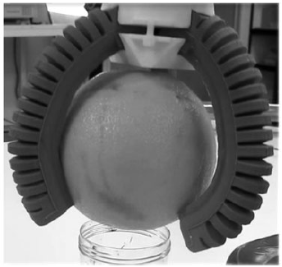
Objective
Soft Robotic mechanisms:
Found in robot end-effectors
Used for gentle or flexible grasps
Best option in harsh environments (underwater)
Material properties/geometries determine stiffness
This project aims to simulate discrete motion of multi-finger soft robotic gripper especially with programmable variable stiffness for an underwater environment
Notes:
One of the largest applications of soft robotic mechanisms is found in robot end-effectors. The advantages of soft grippers are found in applications that require gentle or flexible grasps, like picking up fruit or cacti. Soft grippers are often the best option in especially harsh environments, namely underwater, due to their ability to passively adapt to external stimuli. Most of the grippers seen in literature are made of multiple single degree of freedom elastic fingers that wrap around the given object. This project aims to model one of those grippers. Specifically, introducing the concept of a gripper with programmable variable stiffness in an underwater environment.
The objective of the project is to simulate discrete motion of multi-finger soft robotic gripper especially with programmable variable stiffness for an underwater environment.
Ben Forbes: I am a PhD student in Dr. Veronica Santos' Biomechatronics lab at UCLA, working on a project that creates a novel controller for underwater end effectors that considers tactile data. This project runs tangential to the work being done currently, and explores modeling viscous forces and contact underwater. While the type of end effector is drastically different to the work I am currently doing, it provides insights into how I can simulate gripping and actuation in an underwater environment.
Premkumar Sivakumar: As a graduate student specializing in Robotics, I am intrigued to learn new methods to model and simulate the motion of robotic structures. While Finite Element Based modeling of rigid structures is familiar to me, Discrete Differential Geometry based simulation of the motion of soft robots is new to me and interests me. The discrete simulation of the soft robotic gripper would provide me great exposure to the same.

Slide 4
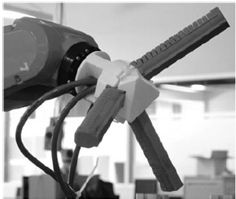
Problem Setup
Three fingers attached to the gripper housing
Each finger is a chamber-based pneumatic actuator
Fingers made of elastomeric silicone designed with ridges, embedded with a bistable layer
The bistable layer is inextensible, turning any extension force into bending moment – no stretching
Motion of the gripper finger is confined to a plane – no twisting
Notes:
The physical soft robotic gripper has three fingers, where each finger is a chamber-based pneumatic actuator made up of elastomeric silicones embedded with a bistable layer, like a thin flexible metal. The elastomeric part is designed with ridges which allows the finger to bend. However, since the elastomeric part can bend under its own weight without any actuation, the embedded bistable layer offers rigidity making the actuator behave stiff under zero input conditions. But at a reasonably small input pressure would shift to its second state of mechanical stability, allowing bending. This bistable layer would also be inextensible, preventing any lateral extension, turning any extension force into bending moment. Motion of the gripper finger is confined to a plane – so no twisting

Slide 5
Methods
Gripper modelled as N nodes connected by N-1 edges, with first node fixed:
Analogous to discrete elastic cantilever beam in viscous medium
Forces:
Elastic force – from local elastic bending energy at each discrete node
Inertial force – the mass of the actuator is distributed as point masses at different nodes
External force – viscous force from water
Notes:
The goal of the formulation is to build a numerical simulation tool for a soft robotic gripper that draws inspiration from discrete differential geometry based simulation of slender structures. Simulation of the actuation of the underwater soft robotic gripper described above is essentially that of a discrete elastic cantilever beam in viscous medium, which can be modelled as N nodes connected by N-1 edges. The mechanical deformation of the gripper finger is associated with local elastic bending energy at each discrete node. We compute the inertial force, external forces and formulate the discrete elastic energies and, subsequently, the discrete equations of motion representing the balance of forces using principles from classical elastic rod theories (Euler-Bernoulli Beam Theory). For the inertial force calculation, the mass of the fingers of the gripper is distributed as point masses at different nodes. The external force acting on the gripper will be the viscous force from water.

Slide 6
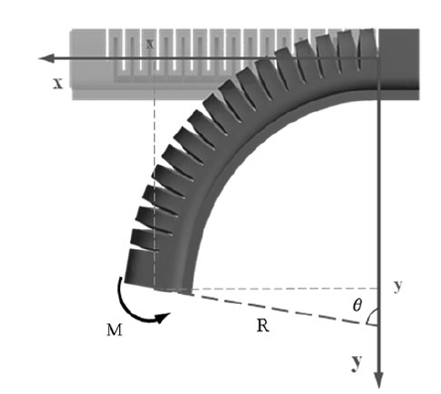
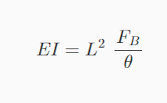
Methods
Elastomeric materials exhibit non-linear properties
Effective modulus of elasticity is calculated based on experimental bending angle and blocking force with pressure from literature
F_b is the blocking force, theta is the bending angle and L is the length of the actuator
Notes:
as the actuators are made up of composite structure and elastomeric materials with non-linear properties, the effective modulus of elasticity of the actuators are calculated from the experimental bending angle and block force versus pressure. Fb is the blocking force, theta is the bending angle and L is the length of the actuator.

Slide 7
Methods
Implicit treatment of the elasticity of gripper fingers.
A small enough time step size dt and a large enough number of nodes N will be chosen based on sensitivity analysis
Pneumatic actuation is given as an input by varying curvature (kappa) and hence the bending stiffness with time
First node is fixed and the remaining nodes are free to move in a plane from the initial configuration
The initial configuration of the fingers will be straight and in horizontal or oblique position with respect to the gripper housing
The contact forces with the object for grasping is yet to be decided
Notes:
The simulation incorporates an implicit treatment of the elasticity of the gripper fingers. A small enough time step size dt and a large enough number of nodes N will be chosen based on sensitivity analysis for the simulation. The motion of the gripper is driven by pneumatic actuation which is given as an input by varying curvature (kappa) and hence the bending stiffness with time. Here the first node is fixed and the remaining nodes are free to move in a plane from the initial configuration. The initial configuration of the fingers of the gripper will be straight and in horizontal or oblique position with respect to the gripper housing. The contact forces with the object for grasping is yet to be decided.

Slide 8
References
Huang, W., Huang, X., Majidi, C. et al. Dynamic simulation of articulated soft robots. Nat Commun 11, 2233 (2020). https://doi.org/10.1038/s41467-020-15651-9
Alici et al. Modeling and experimental evaluation of bending behavior of soft pneumatic actuators made of discrete actuation chambers. Soft Robotics Vol. 5, No. 1 (2018). https://doi.org/10.1089/soro.2016.0052
Hao Y, Wang T, Ren Z, et al. Modeling and experiments of a soft robotic gripper in amphibious environments. International Journal of Advanced Robotic Systems. 2017;14(3). doi:10.1177/1729881417707148
Yin Haibin, Kong Cheng, Li Junfeng, Yang Guilin. Modeling of grasping force for a soft robotic gripper with variable stiffness. Mechanism and Machine Theory, Volume 128, 2018, Pages 254-274, ISSN 0094-114X. https://doi.org/10.1016/j.mechmachtheory.2018.05.005.
Zhou, Y., Headings, L. M., and Dapino, M. J. (November 15, 2021). "Modeling of Soft Robotic Grippers Integrated With Fluidic Prestressed Composite Actuators." ASME. J. Mechanisms Robotics. June 2022; 14(3): 031001. https://doi.org/10.1115/1.4052699
Y. Zhou, L. M. Headings and M. J. Dapino, "Modeling of Fluidic Prestressed Composite Actuators With Application to Soft Robotic Grippers," in IEEE Transactions on Robotics, vol. 38, no. 4, pp. 2166-2178, Aug. 2022, doi: 10.1109/TRO.2021.3139770.
J. Shintake, V. Cacucciolo, D. Floreano, H. Shea, Adv. Mater. 2018, 30, 1707035. https://doi.org/10.1002/adma.201707035
https://newatlas.com/underwater-exploration-soft-robotic-hands/41433/

Slide 9
Thank you!

